Slide 1

Siremar
CSE-5335: Presentation
Group 12
Presented By-
Nudrat Nawal Saber
Feng Jiang
Sankalp Sandeep Singh
Section: 5335-002
SPRING 2022

Slide 2
About Siremar…
Siremar aims to keep a dynamic count of all residents of the Margarita Island so that the island can get a stable, sound budget from Central Government
Siremar has three type of Users:
Resident
Inspector
SuperAdmin
It provides a lot of benefits to residents,In order to achieve such benefits the residents have to get registered.
It also has a chat feature among residents,admin, and inspectors

Slide 3



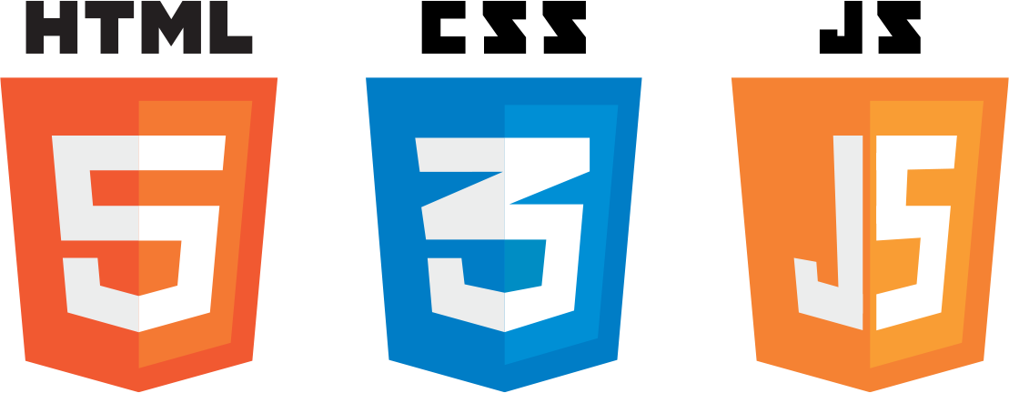
Tools that are used:
Html,CSS: For designing purpose
React :for building user interfaces based on components
PHP : for making dynamic and interactive Web pages
Laravel : framework development of web applications with the help of Model-View-Controller (MVC) design
MySql : For storing and managing database
Node js : for the chat function

Slide 4


Pages before Login
HOME PAGE
BLOG
ABOUT PAGE
CONTACT PAGE
SERVICES PAGE
LOGIN PAGE
Pages After Login
Pages corresponding to
roles
Manage the functions according to the roles
Chat features

Slide 5
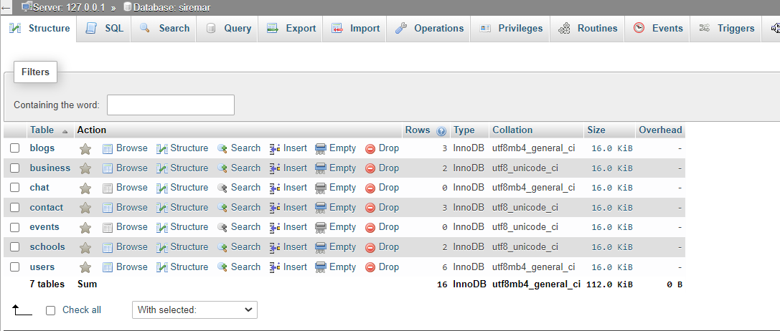
DataBase

Slide 6
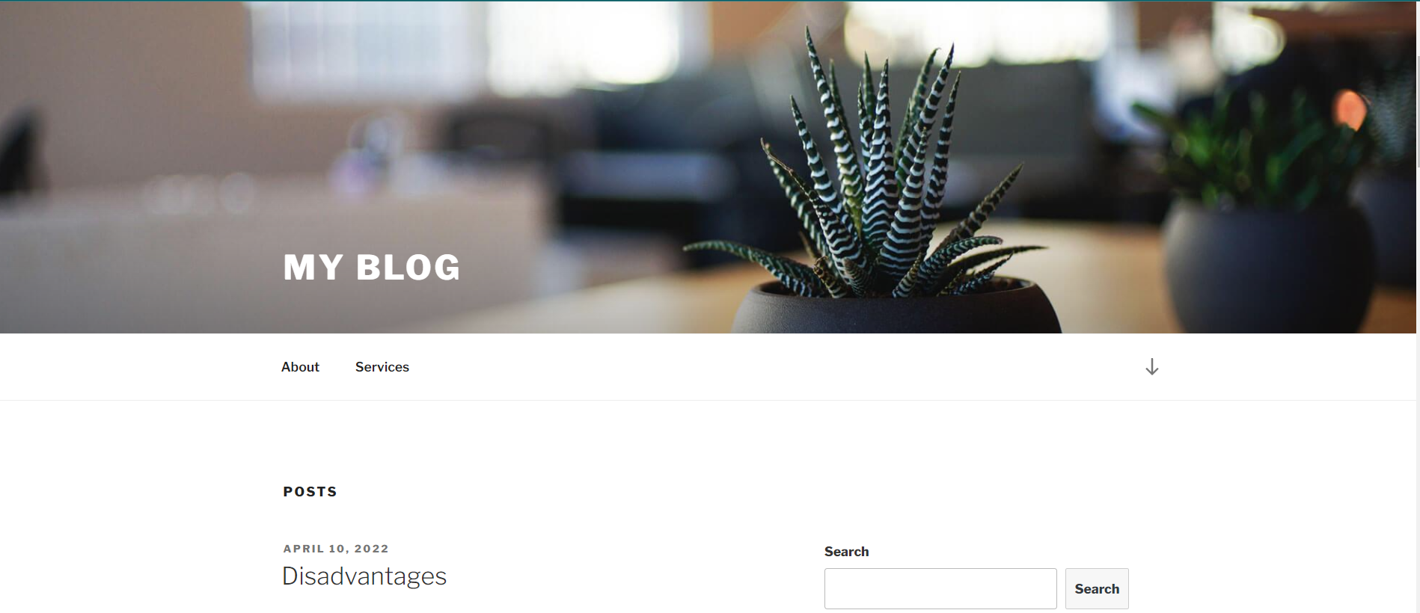
Demo
Page :Blog

Slide 7

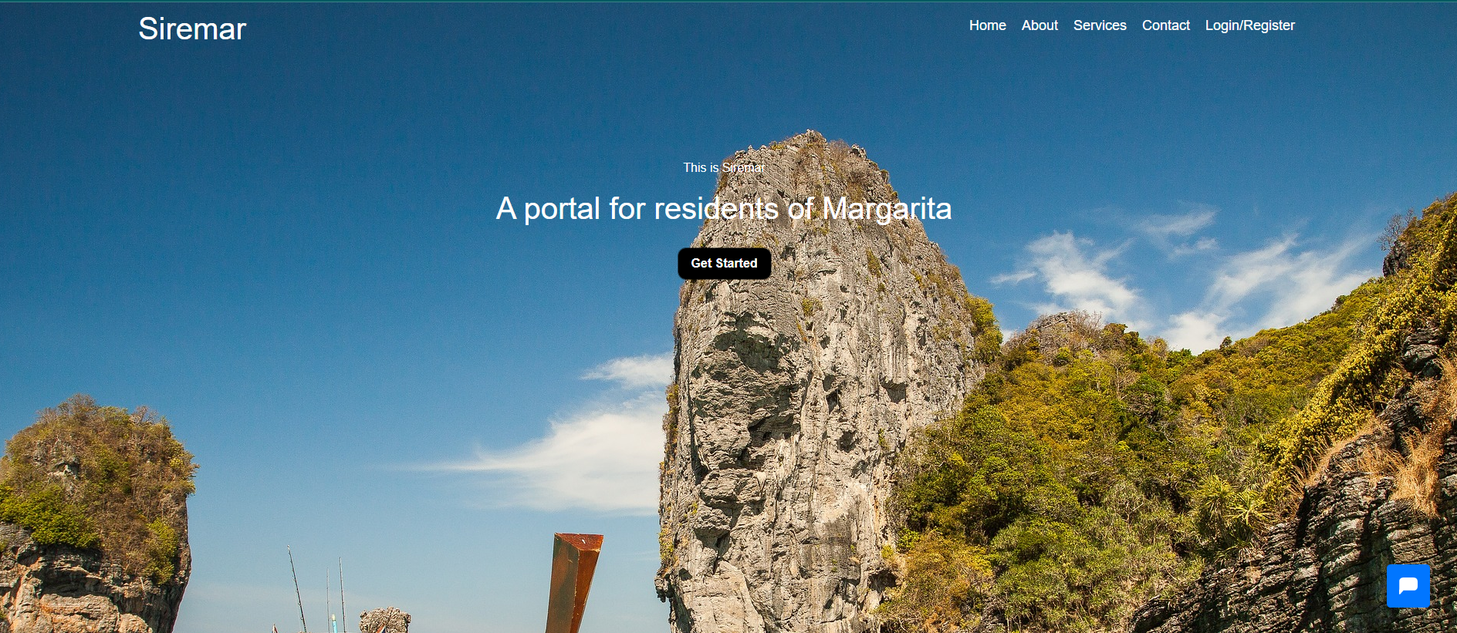
Demo
Page :Home
Home page

Slide 8
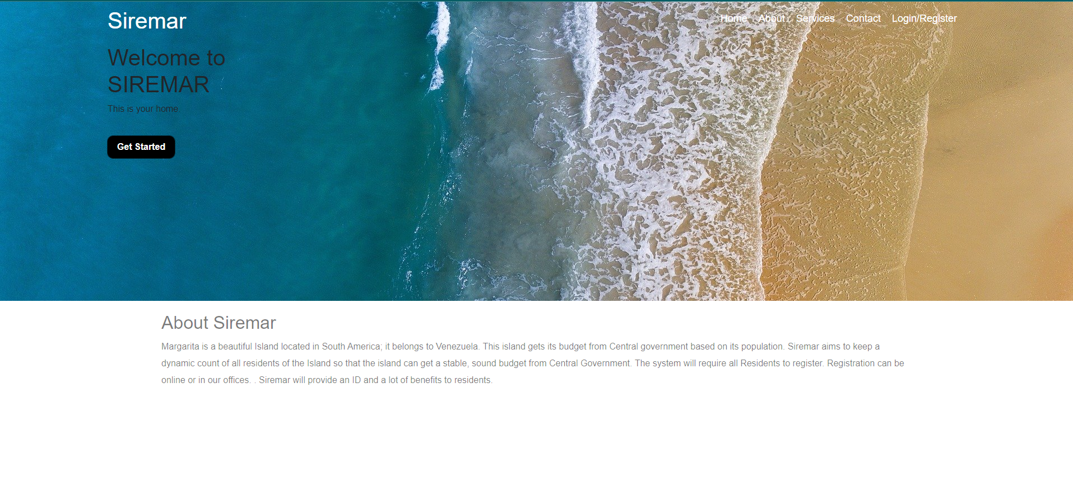
Demo
Page : About Us

Slide 9
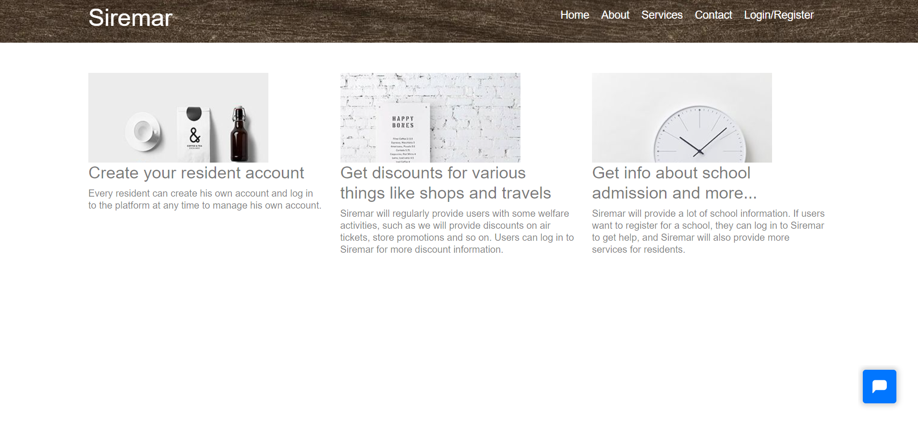
Demo
Page : Services

Slide 10
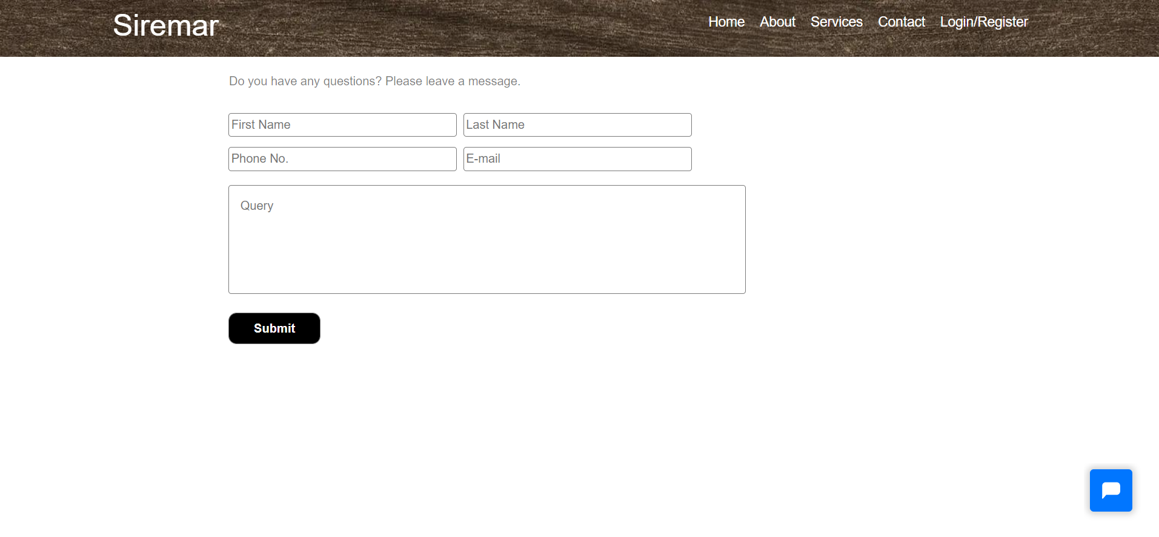
Demo
Page : Contact

Slide 11
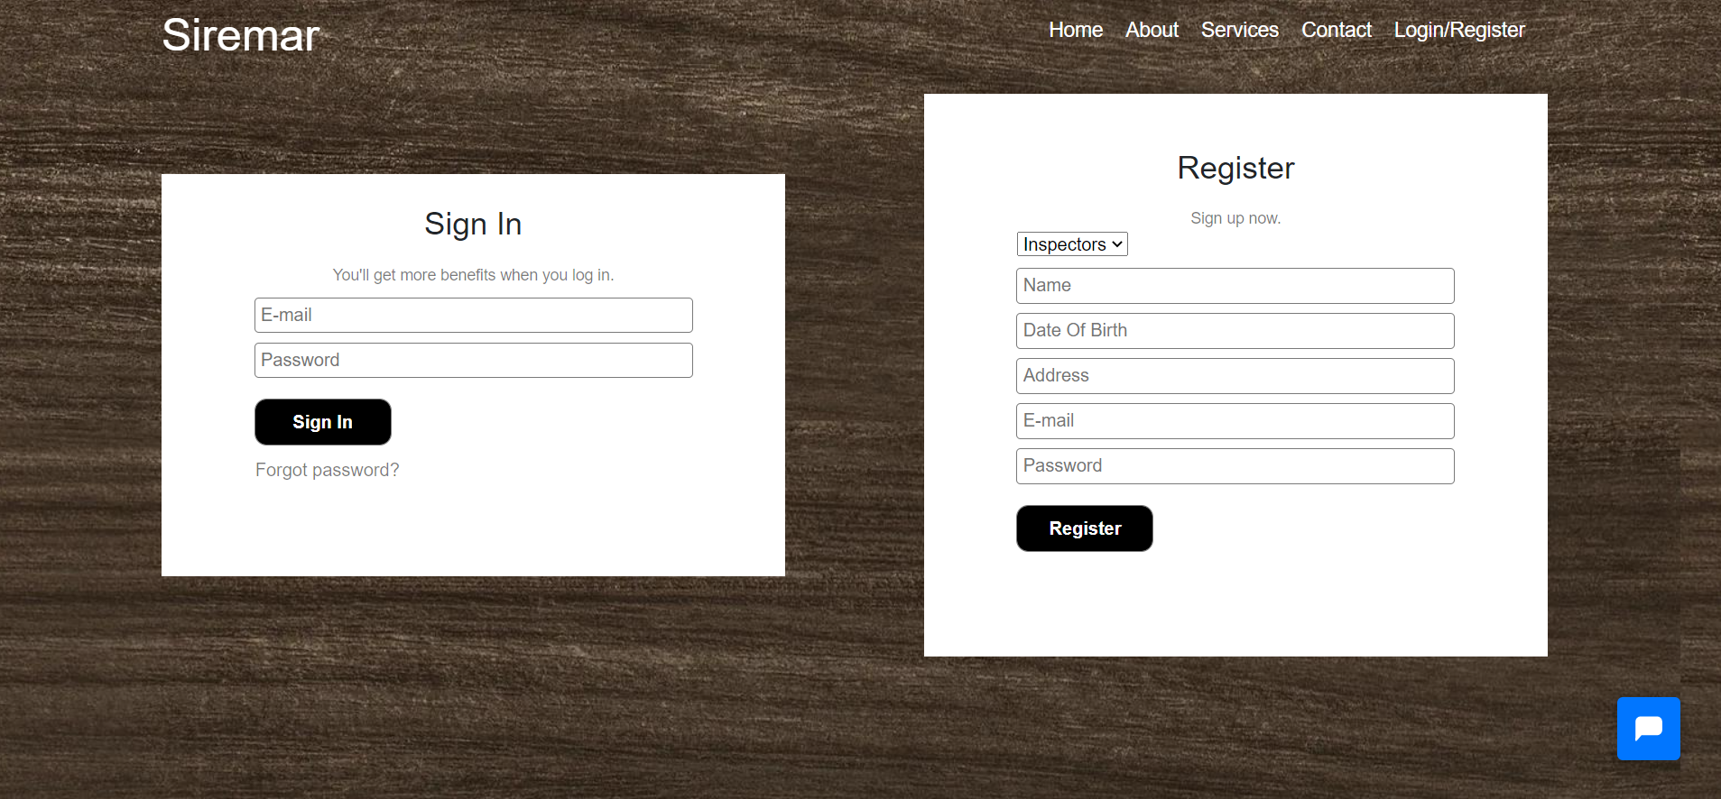
Demo
Page : Registration/login

Slide 12
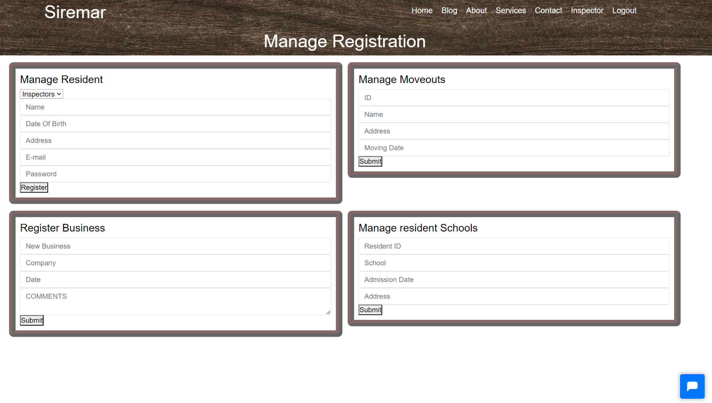
Demo
Page : Inspector

Slide 13
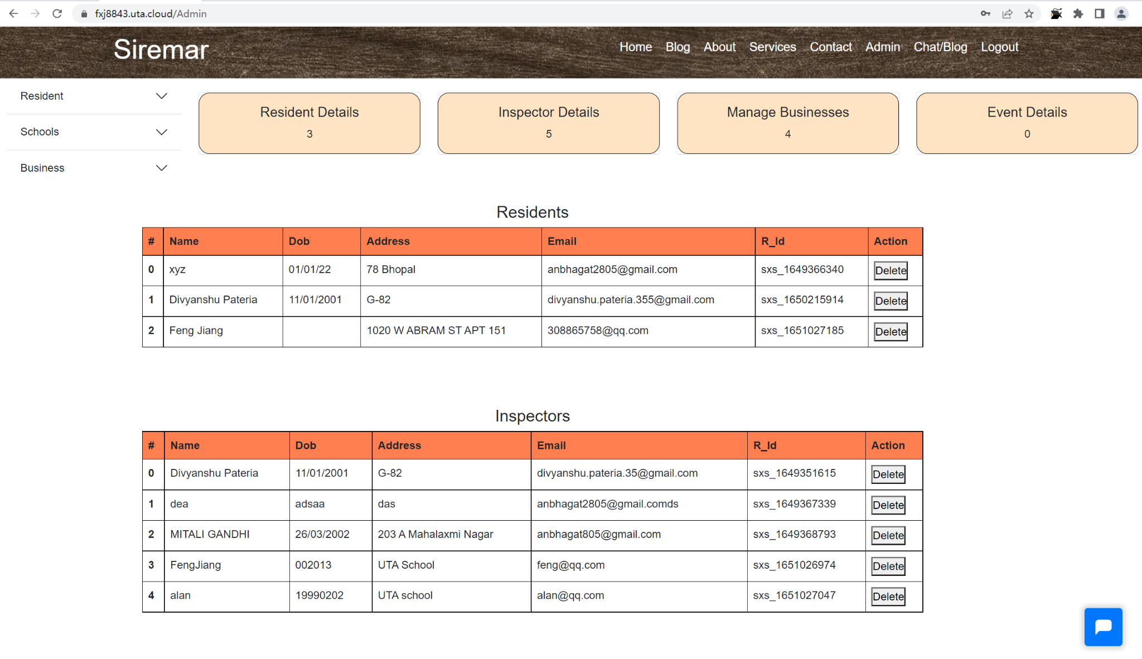
Demo
Page : Admin

Slide 14
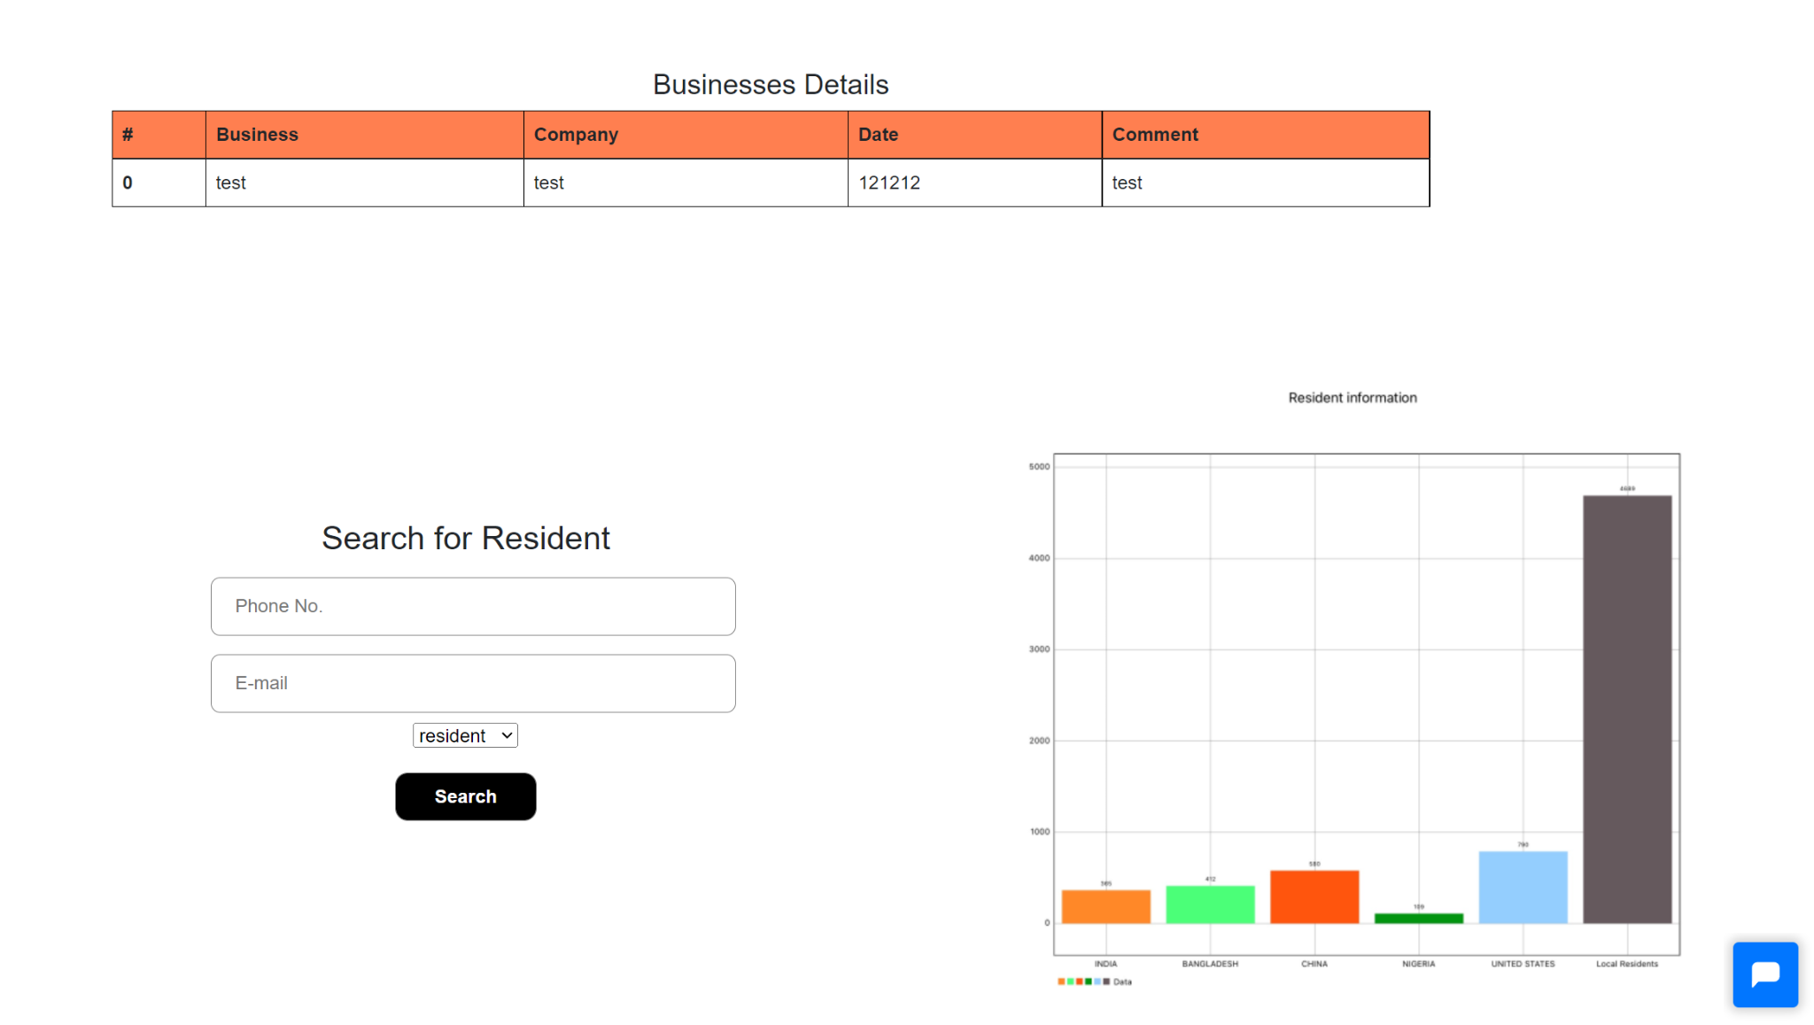
Demo
Page : Admin

Slide 15

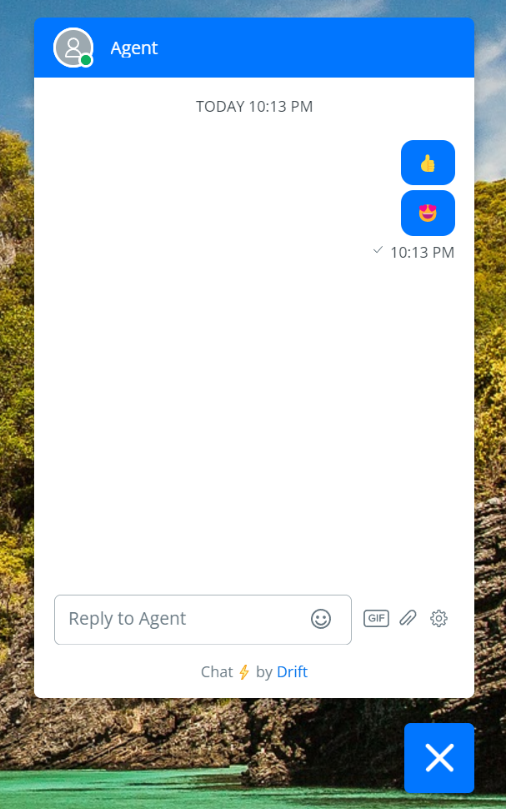
Demo
Chat
while chat box is minimized
while chat box is opened

Slide 16
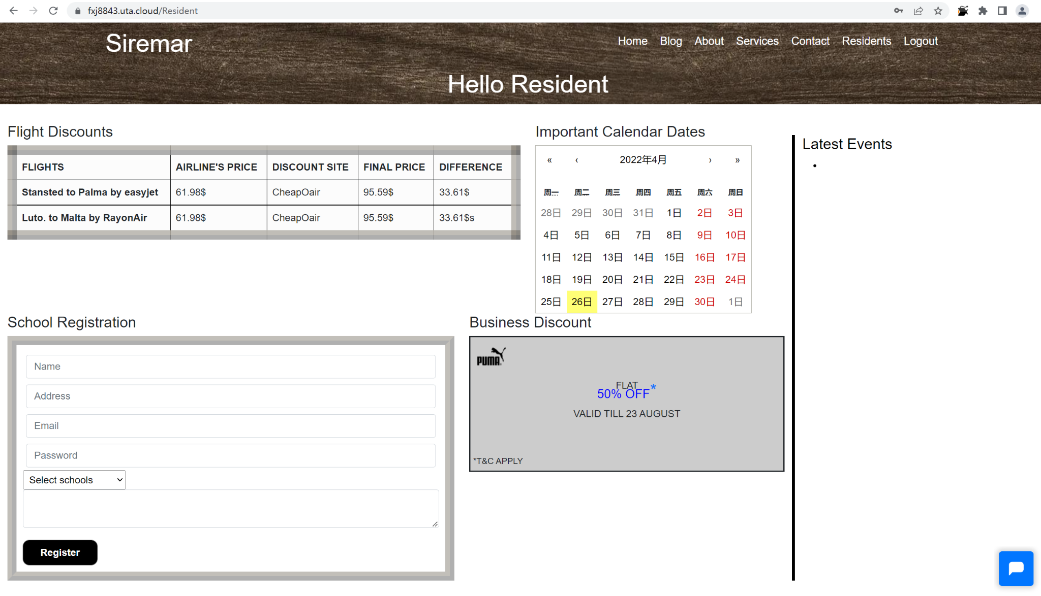
Demo
Page : Residents

Slide 17

Challenges Faced
Lack of communication due to tight schedules.
Inadequate skills of team members
Time limitation
It was a bit difficult to make team decisions.

Slide 18

Creative Functionalities
Chat function is workable for all 3 types of users
Residents Can see the important calendar Dates
User can post comments in blog

Slide 19

Improvement
Make some changes in user interface
Add profile page for the users
Add security by validating
Make users able to get registered with google
and facebook accounts

Slide 20

Future Addition to Portfolio
It is the complete package of full stack project
laravel and react are so popular in these days
It has also some works in wordpress

Slide 21

Thank You

